Slide 1
Java EE Training Course
Web services. JAX-WS
Notes:
ATS Application Programming: Java Programming
Brown Bag: XML
© Accenture 2005 All Rights Reserved
Course Code #Z16325

Slide 2
Agenda
Web services overview
SOAP and WSDL
JAX-WS specification & annotations
JAX-WS implementation - Apache CXF
Consuming JAX-WS
Notes:
ATS Application Programming: Java Programming
Brown Bag: XML
© Accenture 2005 All Rights Reserved
Course Code #Z16325

Slide 3
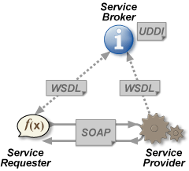
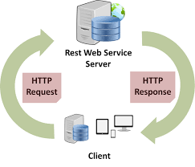
Web Services
Web service - a service offered by an application to another application, communicating with each other via the World Wide Web.
HTTP transfers web service requests and responses in XML and JSON.
Arbitrary Web services, in which the service
may expose an arbitrary set of operations
(JAX-WS, SOAP)
REST-compliant Web services , which
manipulate XML(JSON) representations
of Web resources (JAX-RS)
http://restsever:8080/cutomers/1
Notes:
ATS Application Programming: Java Programming
Brown Bag: XML
© Accenture 2005 All Rights Reserved
Course Code #Z16325

Slide 4
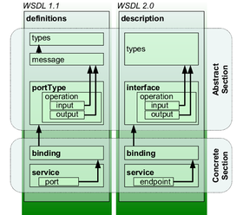
WSDL
The Web Services Description Language (WSDL) - an XML-based interface definition language that is used for describing the functionality offered by a web service.
Types – XSD definition of objects used in requests and responses of web service.
Converted to Java Classes by JAXB.
Interface – definition of WS operations (methods) with its parameters and return values
Service – definition of WS endpoint (service URL)
Notes:
ATS Application Programming: Java Programming
Brown Bag: XML
© Accenture 2005 All Rights Reserved
Course Code #Z16325

Slide 5
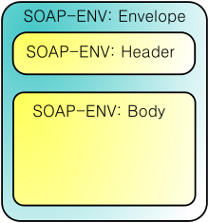
SOAP
SOAP (Simple Object Access Protocol) - a protocol specification for exchanging structured information in the implementation of web services.
<soapenv:Envelope xmlns:soapenv="http://schemas.xmlsoap.org/soap/envelope/" xmlns:com="http://comment.coarsegrained.services.clm.cbr.accenture.com/">
<soapenv:Header/>
<soapenv:Body>
<com:addComment>
<com:entityId>1</com:entityId>
<com:entityType>CLAIM</com:entityType>
<com:text>Новый комментарий</com:text>
<com:userId>cbr_operator</com:userId>
<com:taskDescription>Обогащение</com:taskDescription>
</com:addComment>
</soapenv:Body>
</soapenv:Envelope>
Notes:
ATS Application Programming: Java Programming
Brown Bag: XML
© Accenture 2005 All Rights Reserved
Course Code #Z16325

Slide 6
JAX-WS
Java API for XML Web Services (JAX-WS) - a Java programming language API for creating web services, particularly SOAP services.
Service Endpoint Interface (SEI)
@WebService
public interface CustomerService {
@WebResult(name = “customers") List<Customer> findCustomers(
@WebParam(name = "request”) FindCustomersRequestVO findCustomersRequest);
}
Service Implementation
@WebService(endpointInterface = "com.accenture.jeetraining.CustomerService")
public class CustomerServiceImpl implements CustomerService {
public List<Customer> findCustomers(FindCustomersRequestVO findCustomersRequest) {
….
}
}
Notes:
ATS Application Programming: Java Programming
Brown Bag: XML
© Accenture 2005 All Rights Reserved
Course Code #Z16325

Slide 7
Apache CXF
Apache CXF - an open-source, fully featured Web services framework
(among others implements JAX-WS)
Needed Maven dependencies:
<dependency>
<groupId>org.apache.cxf</groupId>
<artifactId>cxf-rt-frontend-jaxws</artifactId>
<version>${cxf.version}</version>
</dependency>
<dependency>
<groupId>org.apache.cxf</groupId>
<artifactId>cxf-rt-transports-http</artifactId>
<version>${cxf.version}</version>
</dependency>
${cxf.version} –
for example 3.0.8
Notes:
ATS Application Programming: Java Programming
Brown Bag: XML
© Accenture 2005 All Rights Reserved
Course Code #Z16325

Slide 8
Apache CXF. Spring Integration
web.xml
<servlet>
<servlet-name>CXFServlet</servlet-name>
<servlet-class>org.apache.cxf.transport.servlet.CXFServlet</servlet-class>
<load-on-startup>1</load-on-startup>
</servlet>
<servlet-mapping>
<servlet-name>CXFServlet</servlet-name>
<url-pattern>/ws/*</url-pattern> <!–- URL to access web services -->
</servlet-mapping>
application-context.xml
Namespace - xmlns:jaxws="http://cxf.apache.org/jaxws
Schema location - http://cxf.apache.org/jaxws http://cxf.apache.org/schemas/jaxws.xsd
<!-- Service implementor bean -->
<bean id="OrderBatchService“ class="com.accenture.flowershop.fe.ws.OrderBatchServiceImpl" />
<!–- JAX-WS endpoint bean which is picked up by CXF -->
<jaxws:endpoint id="OrderBatchService1" implementor="#OrderBatchService"
address="/OrderBatchService"/>
Notes:
ATS Application Programming: Java Programming
Brown Bag: XML
© Accenture 2005 All Rights Reserved
Course Code #Z16325

Slide 9
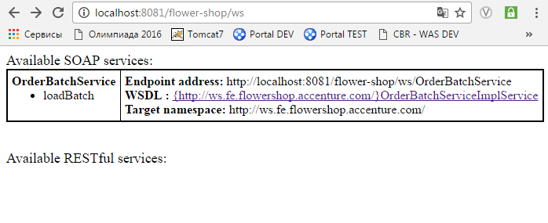
Apache CXF. Result
All services page
Apache CXF.
List of services with WSDLs
Notes:
ATS Application Programming: Java Programming
Brown Bag: XML
© Accenture 2005 All Rights Reserved
Course Code #Z16325

Slide 10
Consuming Web Service
Use <jdk path>/bin/wsimport tool, for example
cmd> wsimport http://localhost:8081/flower-shop/ws/OrderBatchService?wsdl –s C:\\project
http://docs.oracle.com/javase/6/docs/technotes/tools/share/wsimport.html
2. Copy generated client java classes to your projects desired folder
3. User generated service and SEI classes directly:
…
OrderBatchServiceImplService service = new OrderBatchServiceImplService(); // create service
OrderBatchService sei = service.getOrderBatchServiceImplPort(); // get SEI interface
sei.loadBatch(12); // call WS operation
…
4. … or use generated classes with Spring application:
<jaxws:client id=“OrderBatchServiceClient"
serviceClass="com.accenture.flowershop.fe.ws.OrderBatchService"
address="http://localhost:8081/flower-shop/ws/OrderBatchService"/>
Notes:
ATS Application Programming: Java Programming
Brown Bag: XML
© Accenture 2005 All Rights Reserved
Course Code #Z16325

Slide 11
Activity
1. Introduce Apache CXF to flower shop application
2. Implement web service(FlowersStockWebService) with single operation: increaseFlowersStockSize (int count) – increases amount of flowers of all types on count parameter
3. Install SOAP UI application – tool for testing Web Services
https://www.soapui.org/
4. Load your WSDL to SOAP UI and test increaseFlowersStockSize service
5. Create standalone Java application with Web service client for FlowersStockWebService. Application should call increaseFlowersStockSize each 10 minutes and increase stock size on random number from 10 to 30.
Notes:
ATS Application Programming: Java Programming
Brown Bag: XML
© Accenture 2005 All Rights Reserved
Course Code #Z16325

Slide 12
Questions:
???
Notes:
ATS Application Programming: Java Programming
Brown Bag: XML
© Accenture 2005 All Rights Reserved
Course Code #Z16325

